Slide 1

SAS Customer Intelligence 360
SAS Macro Tools for CI360 API invocation and getting analytic value from ci360 data

Slide 2
Contents
Sample Use Cases
Requirements
Configuration (one time)
Downloading Data
Clean/prepare Data
Customer Level Analytical Base Table (ABT) creation Example
Factorization Machine Recommender Example
Upload Results for execution in CI360 tasks/activities

Slide 3
Sample use cases
Predict likelihood to convert for visitors using ci360 data as predictors and a ci360 event as the conversion event
Predict expected response value (e.g. revenue) given a conversion and use this to target special offers to encourage visitors with high expected revenue to convert
Create CI360 segment (and use for task targeting) based on model scores that target those customers most likely to convert
Build a content recommender and associated top X recommendations and upload the resulting personalized recommendations for execution with a ci360 task
Create forecasts of expected future web activity based on past data

Slide 4

ANALYTIC DATA FLOW
Engage Data
Identity Data
Discover Data
Customer Data HUB
API Gateway &
Agent Framework
Data Prep/ABT Creation
Analytics/ML/AI
Scores/
Segments
SAS Viya
VA Reports
Raw Data

Slide 5
Requirements For using the SAS macros
SAS 9.4 M5+ or Viya 3.5+ Environment
Viya is preferred as much of the code will take advantage of CAS in memory processing when relevant
Install a file uncompressing utility that works on gzip files (*.gz) such as 7zip or the gzip program from https://www.gzip.org/.
After the program is installed, add the location of the gzip program to the PATH environment variable. This is required for SAS program to read .gz files without un-compressing the file.
Ideally (but not required) enable SAS to use the XCMD System Option if possible. For more information, see the SAS Help Center and search for the XCMD option. For enabling XCMD in Viya see this article: SAS Viya 3.5: SAS Studio and SAS Compute Server non-functional improvements
If necessary, create an access point in SAS Customer Intelligence 360 in order to obtain the marketing gateway URL, tenant ID and client secret values

Slide 6
One time configuration
To expose repository SAS macros to SAS/Viya sessions

Slide 7
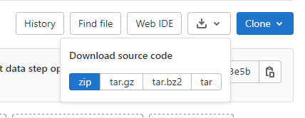
Download the repository files
You will need your own local copies of the files in the repository in order to use them
First step is to download the files from github
Periodically check back for updates/new code and if so re-download the files

Slide 8
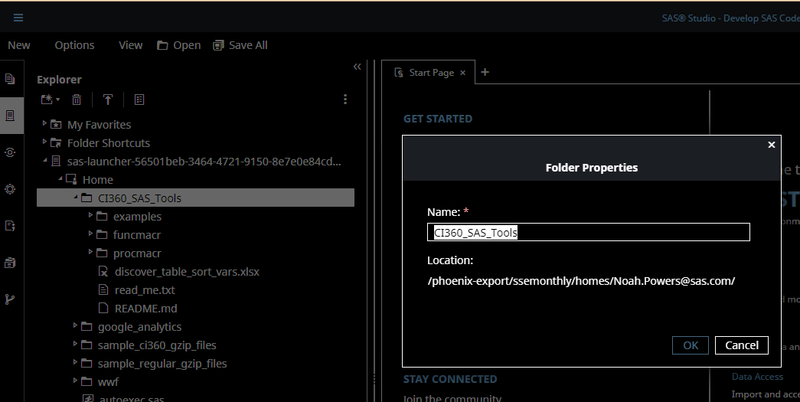
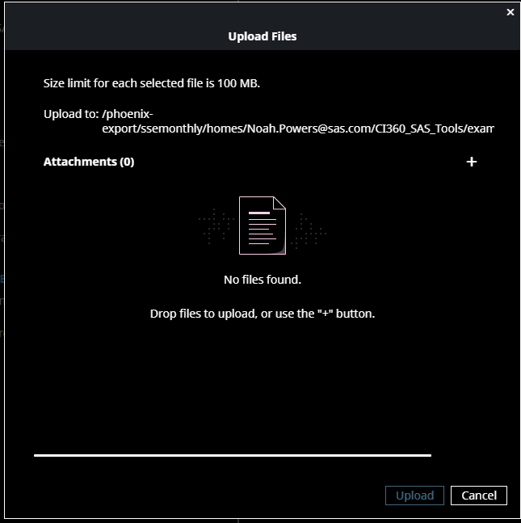
Create folders and COPY/upload files
If using SAS Studio (Viya):
do the following in SAS Studio Explorer
If using SAS 9.4,
do the following in Environment file system
Create main folder to hold files
Create the three subfolders:
Examples
Funcmacr
Procmacr
Upload the unzipped, downloaded files into each subfolder

Slide 9
Don’t edit/change repository files
At some point in the future, there will be updates, fixes and/or new code available in the repository
If you make changes to a repository file and then re-download the files, your changes will be overwritten and lost
Best Practice: make a copy and edit the copy for any repository file you wish to leverage (e.g. example code in examples folder)

Slide 10
Expose macros to SAS sessions
The simplest way to expose the macros to your SAS session, is to submit the following statements EVERYTIME you start a new SAS session (updated with your local path):
filename FuncMcro "<my local path where saved files>/funcmacr" ;
filename ProcMcro "<my local path where saved files>/procmacr" ;
options mautosource insert = (sasautos = ( FuncMcro ProcMcro )) ;
In order to validate that this worked, submit the following statement in your SAS session and check the SAS log:
%put %words(how many words are there?) ;
You should see the value 5 printed in the SAS log. If you get an error about the macro words not found then, something went wrong with the code – likely an incorrect path in one or more of the filename statements above

Slide 11
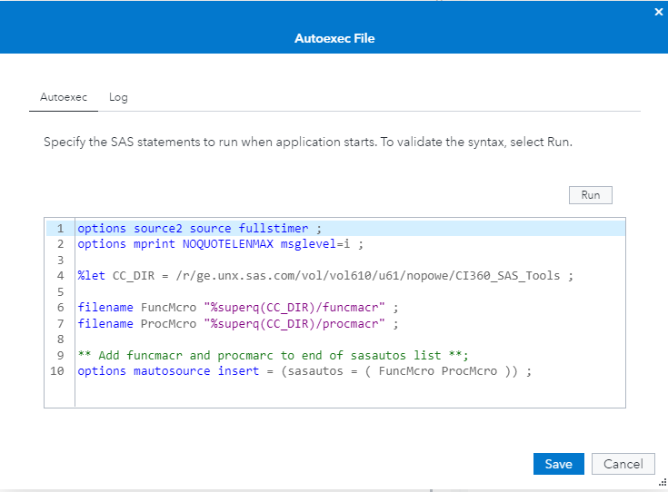
One time only: Configure autoexec in VIYA SAS studio
Instead of submitting the statements on previous slide every time, you could leverage the SAS AUTOEXEC feature to run code every time a SAS session is started
Under Options | autoexec file in SAS Studio
Copy code in speaker notes below and change the value of CC_DIR for your environment
In order to validate that this worked, submit the following statement in your SAS session and check the SAS log:
%put %words(how many words are there?) ;
You should see the value 5 printed in the SAS log. If you get an error about the macro words not found then, something went wrong with the code – likely an incorrect path in one or more of the filename statements above

Slide 12
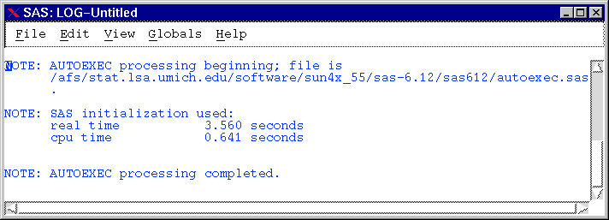
One time only: Configure autoexec in SAS 9.4
With SAS 9.4 there are a variety of ways to set up the AUTOEXEC functionality. Please refer to the SAS user manual for more details.
In order to validate that this worked, submit the following statement in your SAS session and check the SAS log:
%put %words(how many words are there?) ;
You should see the value 5 printed in the SAS log. If you get an error about the macro words not found then, something went wrong with the code – likely an incorrect path in one or more of the filename statements above

Slide 13
How the macros are organized
The macros in the funcmacr folder are ALL written exclusively with SAS macro code and can (in theory) be run from ANYWHERE in your SAS programs. These macros are leveraged extensively by the macros in the procmacr folder.
The macros in the procmacr folder all have a comment header that attempts to describe the purpose of the macro and the parameters involved. All of these macros require explicitly passed, named macro parameters.
There are some example pieces of code included in the examples folder that are intended to help the user understand typical ways of using/invoking the macros

Slide 14
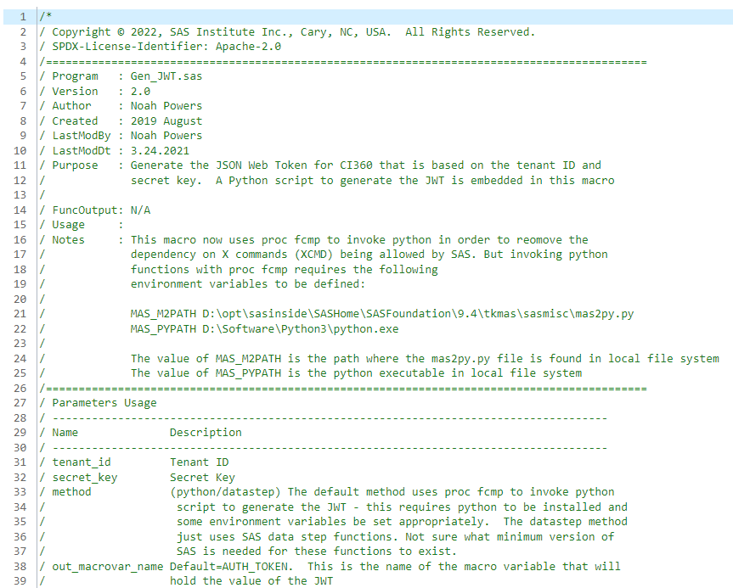
Comment headers explain macros
Every macro has a comment header which provides:
Purpose of the macro
Parameters used by the macro
Default values
Optional parameters
In some cases, additional notes or information is also provided in the comment header

Slide 15
Downloading ci360 data
Part1: download raw gzip files
Part2: read gzip files into SAS datasets

Slide 16
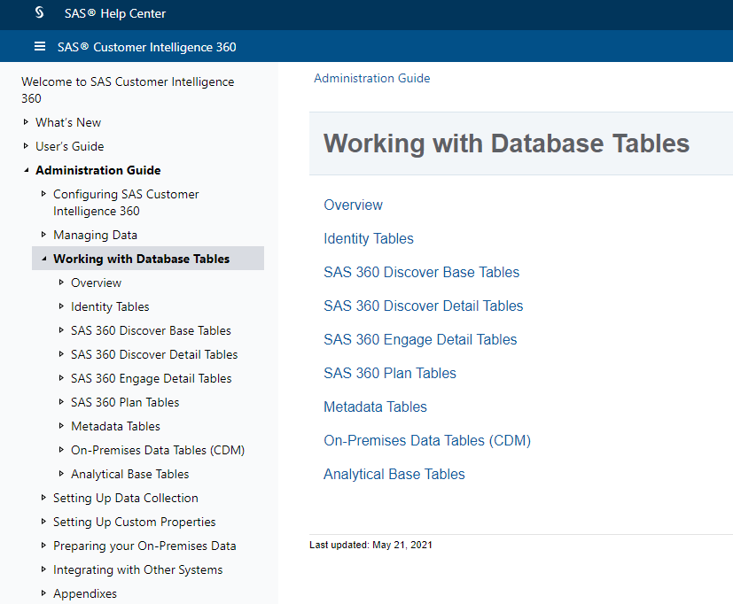
CI360 Data that is collected
CI360 Discover
Detail tables
Base tables
CI360 Engage
CI360 Plan
CDM
Identity tables
Metadata Tables
CI360 ABT Tables
Attribution
Notes:
To see details on the tables available and their layouts go here:
https://go.documentation.sas.com/doc/en/cintcdc/production.a/cintag/p1e2778lgxqmyyn16e7fsvtl4vpm.htm

Slide 17
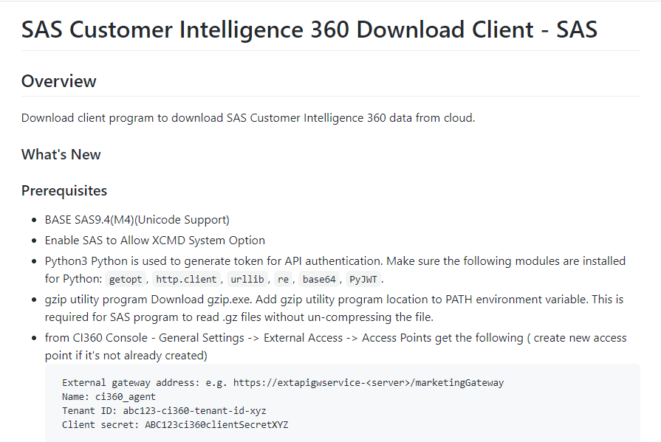
Standard SAS download client
Standard download code intended for constantly downloading data
Requirements:
SAS 9.5 M4 version
X command must be allowed
Python installed and configured (only for JWT)
Gzip
Functionality:
Download Raw gzip files (serially)
Read gzip into SAS datasets
https://github.com/sassoftware?q=ci360

Slide 18
Options for downloading CI360 detail data
If your organization is already using the standard SAS client for downloading CI360 data, you can skip the steps outlined next for downloading data and proceed to the data processing and cleansing section
This repository contains two methods for downloading data:
Single threaded download, best for non-partitioned data
Parallel process download, best for large amounts of partitioned data (e.g. has time periods). This requires XCMD is allowed OR SAS/Connect is licensed/installed.
Note that users are only able to download up to the latest 60 days of CI360 collected data using any of the above methods for downloading data

Slide 19
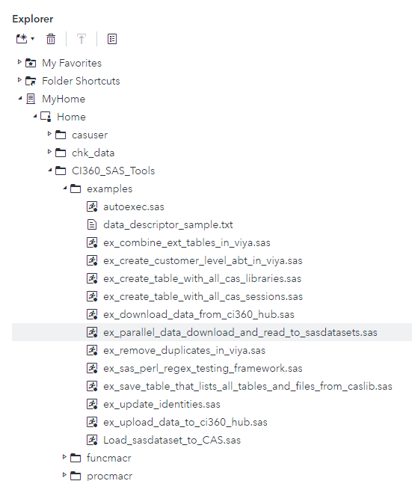
Parallel Download for CI36o discover detail data tables
The following slides illustrate how to set up and run the process for downloading CI360 Discover detail data with parallel processes
Start with a copy of the example code in the examples folder shown to the right -> and save this in a different location
We will edit this file later after some configuration steps
This SAS code will create and run in parallel a number of sub-programs that each download a different time period range of the data.

Slide 20
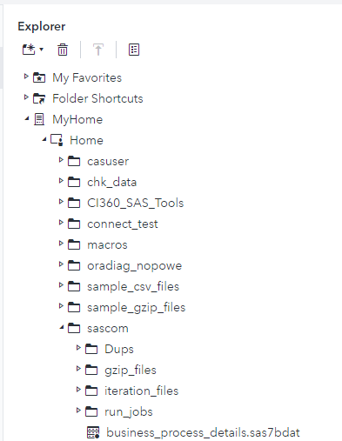
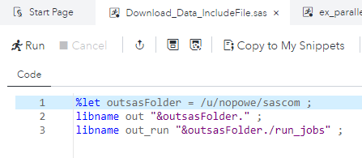
Set up for Parallel Download process
Create the main folder that will eventually hold the SAS dataset versions of the CI360 tables. In this example, that is the “sascom” folder
Create the following sub-folders:
Dups
gzip_files
iteration_files
run_jobs
Inside the run_jobs folder, create a SAS program called “Download_Data_IncludeFile.sas”
Add three lines in this file:
%let outsasFolder = <path to the main folder above> ;
Libname out “&outsasFolder.” ;
Libname out_run “&outsasFolder./run_jobs” ;

Slide 21
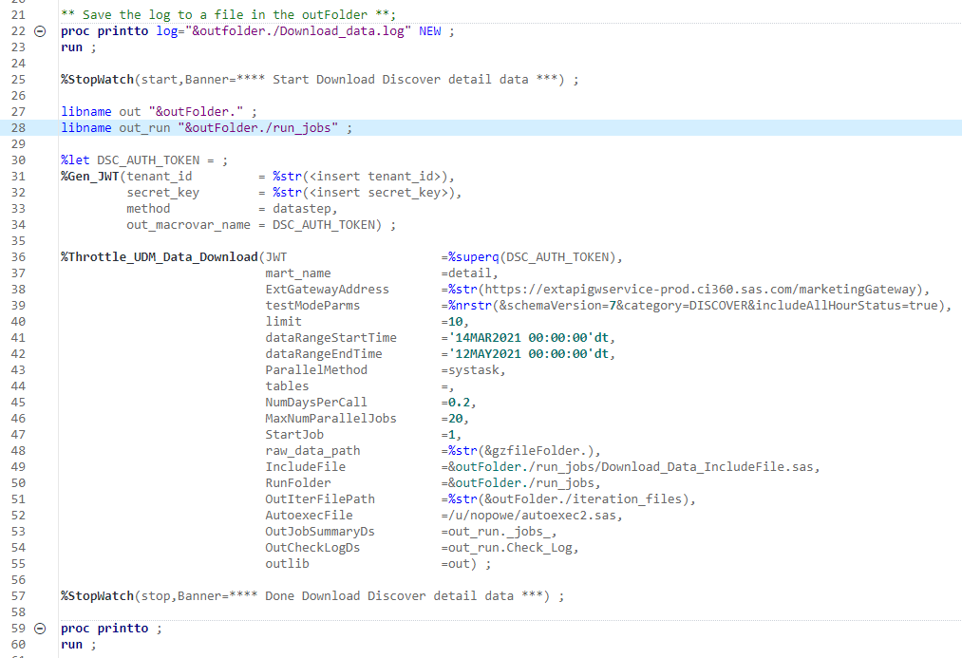
Understanding the example code
Open the copy of “ex_parallel_data_download_and_read_to_sasdatasets.sas” that you created
The proc printto sends the log to a file rather than the log window in SAS Studio. This is recommended in case the log is too large for the log window.
The pair of Stopwatch invocations measures and reports on the time it takes the code in the middle to run.
Lines 30-34 generate the Json Web Token (JWT) for the user provided tenant ID and secret and loads this value into the DSC_AUTH_TOKEN macro variable
Lines 36-55 are the invocation of the parallel download macro (throttle_udm_data_download):
Lines 36-42 are used with the API communications
45-47 drive the total number of sub jobs created as well as how many can run at the same time
48 – end drive where the outputs are saved

Slide 22
editing the example code for step 1
Open the copy of “ex_parallel_data_download_and_read_to_sasdatasets.sas” that you created
Update the value assigned to the outFolder macro variable to match the main folder you just created
Obtain the tenant ID, secret key and gateway address from the CI360 Access Point definition that you created in the requirements section
Copy in the tenant ID and secret key into the %Gen_JWT macro invocation parameter values
Update the value for ExtGatewayAddress using the host value copied from the CI360 UI: https://<External gateway host>/marketingGateway
Create a file with the three SAS statements that were added to SAS AUTOEXEC in the one time configuration section and provide the file path and name as the value of AutoexecFile parameter to the macro
If XCMD is allowed, then set ParallelMethod=systask
If XCMD is NOT allowed, then set ParallelMethod=connect (requires SAS/Connect license)

Slide 23
editing the example code for Step 1
It is a best practice to validate that everything is set up correctly first by restricting to an hour of data and max 1 parallel job before running on the full data. To do this set the parameters as follows:
NumDaysPerCall=1
MaxNumParallelJobs = 1
dataRangeStartTime = SAS datetime constant in latest 60 days
dataRangeEndTime = start time + 1 hour
The following slides will illustrate how to validate that this worked or not
Once the code is working properly, then
change the start and end time values above to be the full desired time range (up to 60 days)
Update NumDaysPerCall value (typical value 0.2-0.5)
Update MaxNumParallelJobs value (typical value between 10-20)

Slide 24
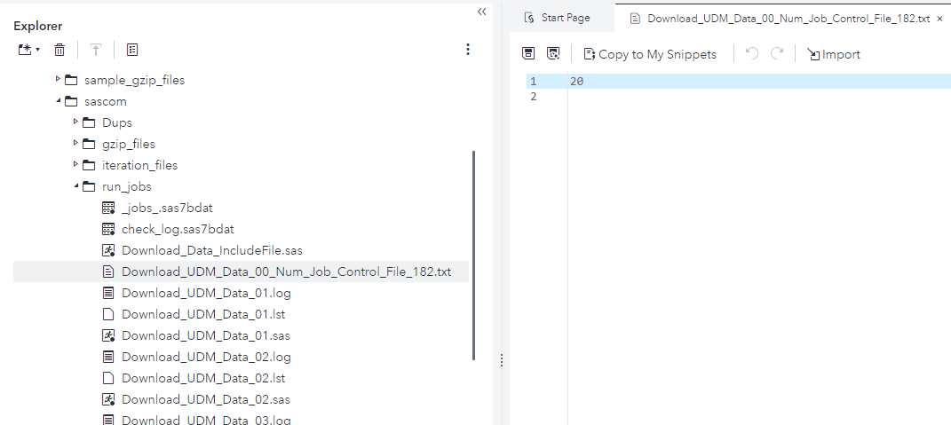
Tuning the number of concurrent jobs
The best number of parallel jobs to use will depend on your environment and system load.
For my Windows desktop environment, I have found 10-20 jobs to be effective
With a value that is too high, performance will degrade but this can be changed on the fly without stopping the main code.
Once the throttle_udm_Data_download macro is running, it creates a “job control” file that enables you to on the fly change the max number of parallel jobs.
Just open the file, change the number to the new desired value and save the file
The next time the macro is done waiting for a job to complete, it will read the new value and adjust accordingly

Slide 25
Validating the download process
The run_jobs folder will contain a collection of SAS programs that each download a different slice of the total time range to download
They will each have their own log file that can be reviewed or investigated if problems arise
It is typical for proc http to fail once in a while, but the main code will automatically try again up to 2x and should work on subsequent attempts

Slide 26
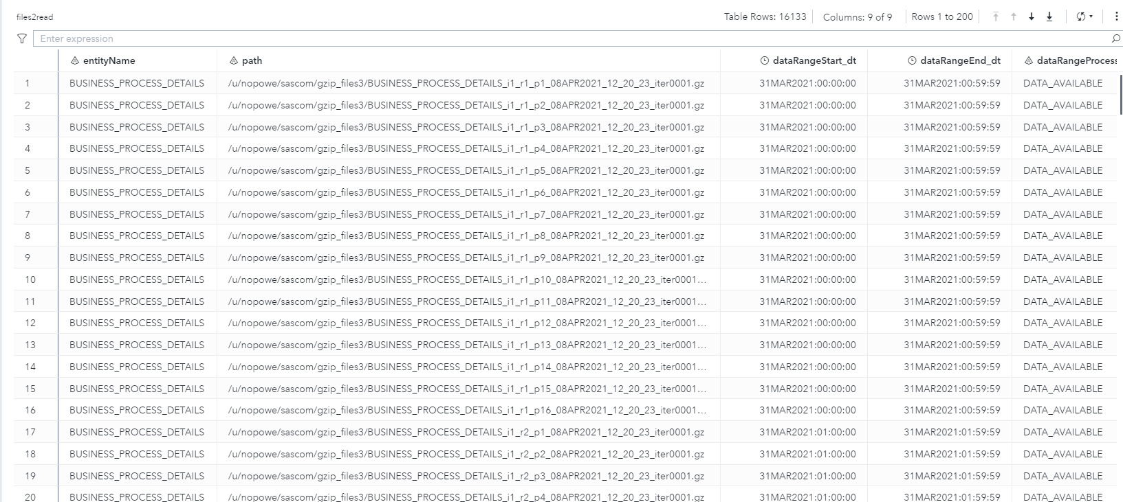
Validating the download process
A successful download will produce three SAS datasets in the output folder. The first one is files2read that has one row for each gzip file downloaded. In the example below, there were 16,133 gzip files downloaded

Slide 27
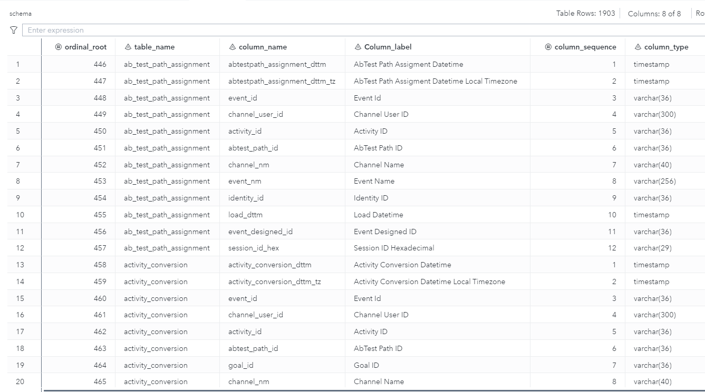
Validating the download process
The second one is schema that has one row for each column in each ci360 data table. This information plus the prior table are used to read the gzip files into SAS datasets that can more easily be loaded into CAS tables

Slide 28
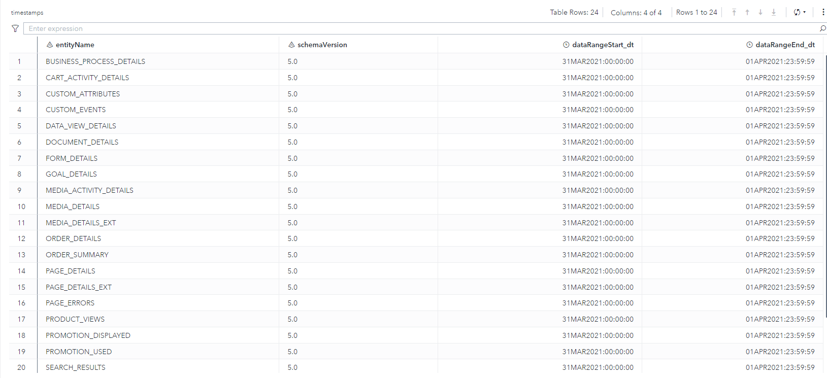
Validating the download process
Lastly, the timestamps SAS dataset is created which has one row for each table with at least one gzip file associated with it. The de-duplication macro will add information about the duplicates removed to this table

Slide 29
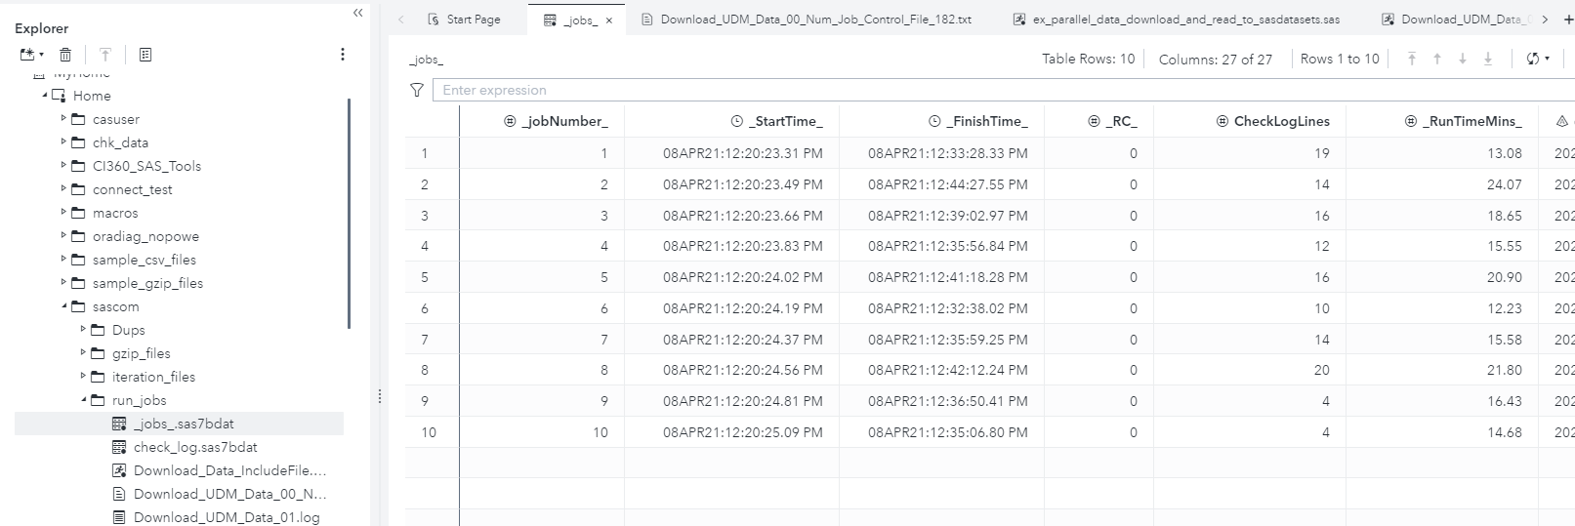
Validating the download process
Once all jobs have completed, a “jobs summary” SAS dataset is created that captures:
All of the related parameters for that job
The return code for each job. Zero is good.
The number of suspicious lines in the log
The run time

Slide 30
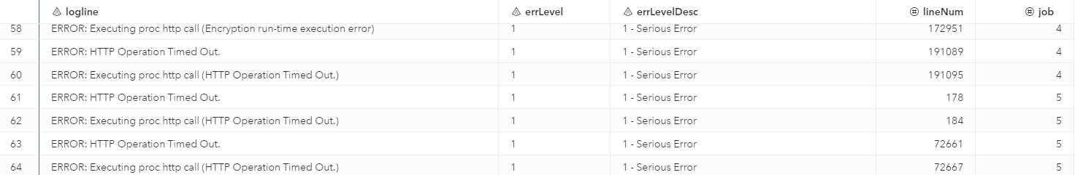
Validating the download process
The check_log SAS dataset compiles all of the warnings/errors and notes of interest across all of the different jobs
The logs for individual jobs should be inspected to determine if proc http eventually did succeed if there are any http errors

Slide 31
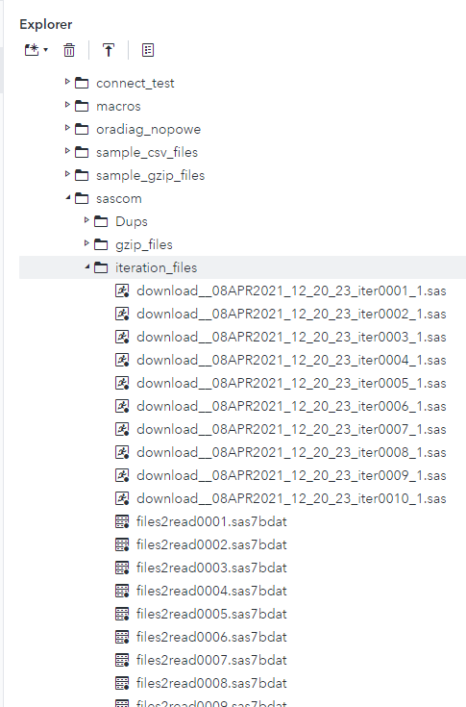
Validating the download process
Iteration files can be useful if something goes wrong which does not happen very often
DON’T open the gzip_files folder as there are most likely thousands of gzip files that will likely take a really long time to show in your SAS Studio session

Slide 32
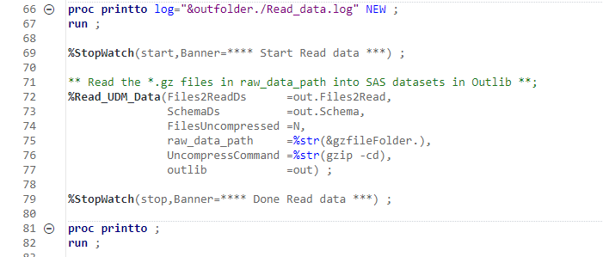
Step 2: Read gzip files into sas datasets
The download programs only download the “raw” gzip files contain delimited text files.
The next step is to read these gzip files into SAS datasets for further cleansing and analysis.
Similarly, to the download program:
The proc printto sends the log to a file rather than the log window in SAS Studio. This is optional.
The pair of Stopwatch invocations measures and reports on the time it takes the code in the middle to run.
If XCMD is allowed, then:
Set UncompressCommand value to an appropriate value for your environment. If you are using gzip, keep the value in the sample code.
If XCMD is NOT allowed, but you have OS level access, then:
uncompress the files directly outside of SAS via OS with gzip/7zip/etc
Set parameter FilesUncompressed=Y
If XCMD is NOT allowed and NO OS level access then:
Set parameter FilesUncompressed=Y
Set parameter UncompressCommand= (e.g. blank/null value)

Slide 33
Clean/prepare ci360 data

Slide 34
Steps to process ci360 data
After the raw gzip files have been downloaded and loaded into SAS datasets, there are a couple steps to process the data for analysis:
Some of the partitioned data tables can contain small numbers of duplicate records that should be removed
Customer identities need to be processed to link anonymous sessions with the known user when possible
For ease of use, “extension” tables or those that end in EXT are joined with the main tables.
I downloaded latest 60 days but now it is 30 days later and I want to add that data in with my previous data
If any event custom attributes were configured and captured with the CI360 UI, the values can be extracted using the “extract_properties_map_doc_cols.sas” macro

Slide 35
Removing Duplicate Records
remove_udm_data_dups.sas
Duplicates are expected but there are typically very few numbers of duplicate records
What causes duplicates?
The browser thinks the event didn’t get through, but it in fact did. And then the browser sends the event again
There are probably other scenarios that have to deal with the interactions of browsers and javascript, but this one is the most common we have seen.
Primary key(s) by table
SAS documentation is working on documenting and publishing these keys for each table
In the mean time, I have created best guess Excel spreadsheet that captures primary key variables included in the repository called “ci360_database_table_sort_vars.xlsx”

Slide 36
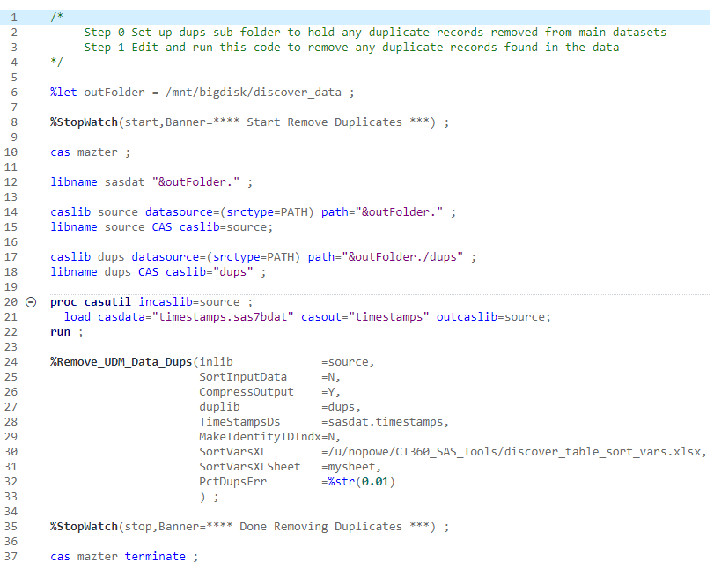
process CI360 data
How to Remove the duplicates:
Make a copy of the “ex_remove_duplicates_in_viya.sas” example code
Start a CAS session
Set up caslibs and associated CAS libnames for source data and “dups” caslib/libname for removed duplicate records
Load timestamps into CAS table
Set up parameters and invoke the remove duplicates macro

Slide 37
Identity Updates
update_identities.sas
Data processing is required for visitors who initially have an anonymous session but later login in order to link to the datahub ID
If this step is skipped, then you will have instances in data where multiple different customer IDs are really the same ID
It is required to download the identity tables (identity_map identity_attributes) for this step
This update must be done PRIOR to aggregating to the customer level

Slide 38
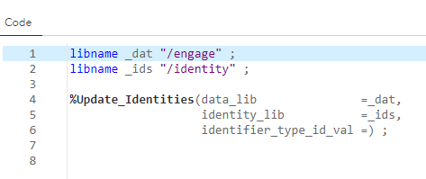
process CI360 data
Make a copy of the “ex_update_identities.sas” code in the examples folder
Set up libnames to the data to update and the identity data
Run the macro

Slide 39
Merge EXT table data into main table
combine_base_and_ext_disc_detail.sas
Session_details and page_details have associated EXT tables that contain total time & total active time metrics across the sessions and pages respectively
It is expected to see some small number of unmatched records between base and EXT tables
Sessions that started just before start date of data will have a record in EXT table but not in base table
Sessions that started just before the end date of data will have a base table record but not an EXT table record

Slide 40
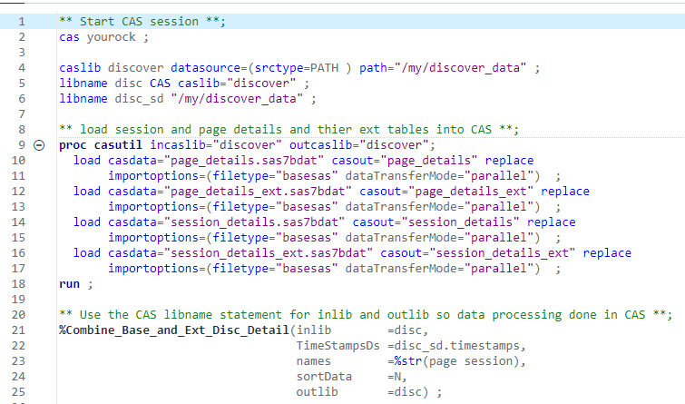
process CI360 data
Combine the detail and extension tables using CAS
Make a copy of the “ex_combine_ext_tables_in_viya.sas » code in the examples folder
Start CAS session
Create Caslib/libname to source data sets
Load all four tables into CAS
Invoke the macro to combine the tables
Next slide shows code to save resulting joined data to sasdatasets

Slide 41
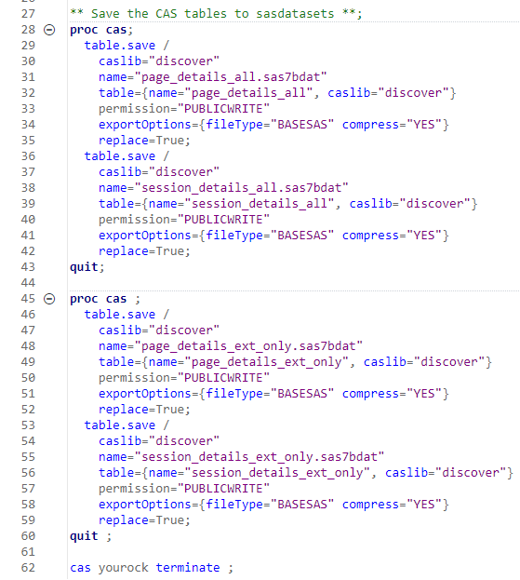
process CI360 data
Save the combined CAS tables and exception CAS tables to SAS datasets on disk for permanent storage

Slide 42
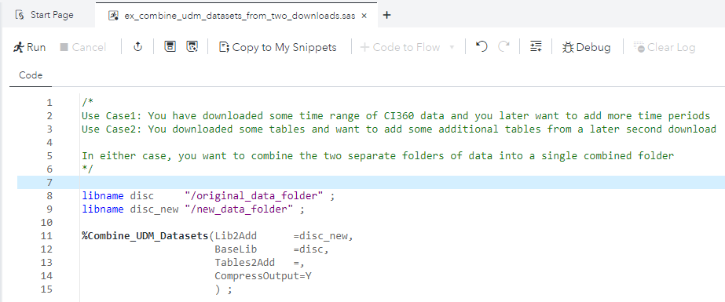
Combine two sets of downloaded data
Use Case1: You have downloaded some time range of CI360 data and you later want to add more time periods
Use Case2: You downloaded some tables and want to add some additional tables from a later second download
In either case, you want to combine the two separate folders of data into a single combined folder
See ex_combine_udm_datasets_from_two_downloads.sas” for an example

Slide 43
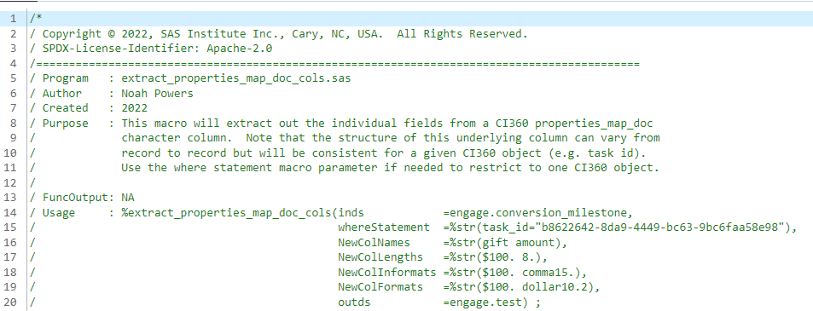
Extract custom attributes
If you have captured custom attributes in events or other CI360 objects that you want to extract, use the “extract_properties_map_doc_cols.sas” macro to do this.

Slide 44
Create customer level modeling analytic base table

Slide 45
General Considerations when building an ABT
What is the Conversion/Target/goal/dependent variable?
Conversions over which time periods?
Make sure that predictors/independent variables only have information BEFORE conversion/goal occurred for converters
Universe of customers to include in the ABT
How much historical data to include?
Metrics that distinguish behaviors between customers
Percent/averages may be stronger predictors than straight counts

Slide 46
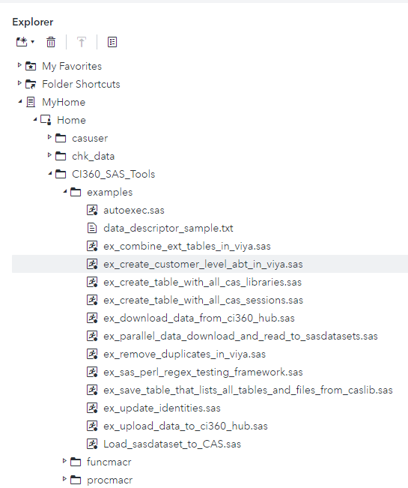
Example 2: create a customer level ABT
The following slides provide more details on how to set up and use the example code to create a customer level ABT for predictive modeling with CI360 data based metrics
Make a copy of this sample code and modify for your needs

Slide 47
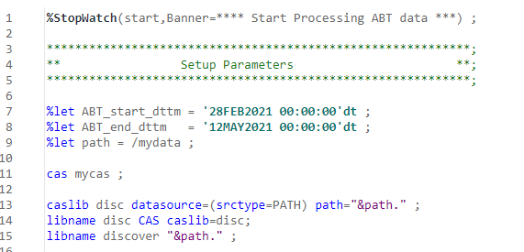
Example 2: create a customer level ABT
Stopwatch is useful to measure the amount of time your process takes to run
Define the start and end datetime values for the ABT
Set up CAS session and caslibs to the underlying CI360 data (already downloaded and processed)

Slide 48
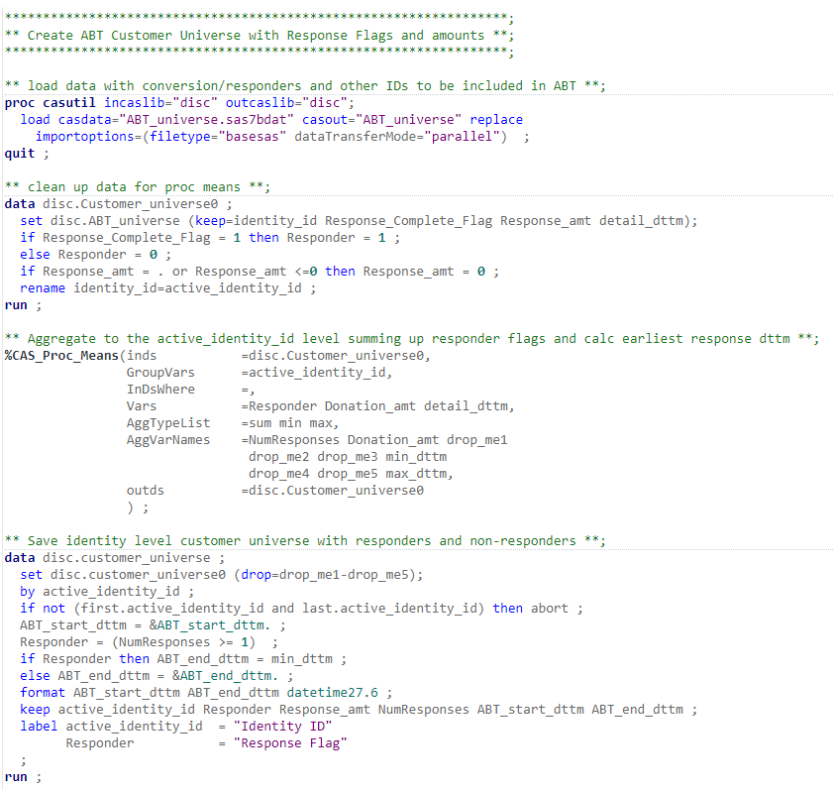
Example 2: create a customer level ABT
Load data containing the universe of customers to be modeled and the dependent variable to be predicted (e.g. some goal achieved)
Determine the datetime of the (earliest) response for each identity, to ensure that no information after that is used for prediction
(not shown) Drop CAS tables no longer needed to free up memory

Slide 49
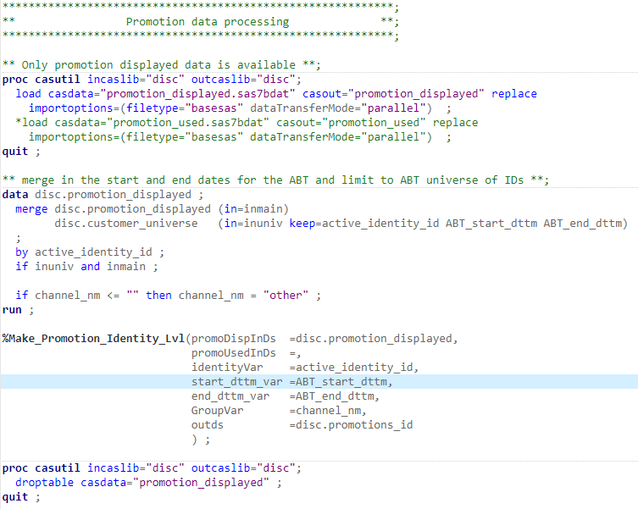
Example 2: create a customer level ABT
For each CI360 data source to incorporate into the ABT:
Load data table(s) into CAS
Limit data to the datetimes/customers of interest
Invoke the macro to process promotion data
Drop CAS tables no longer needed
In this example there were no promotion_used data to load

Slide 50
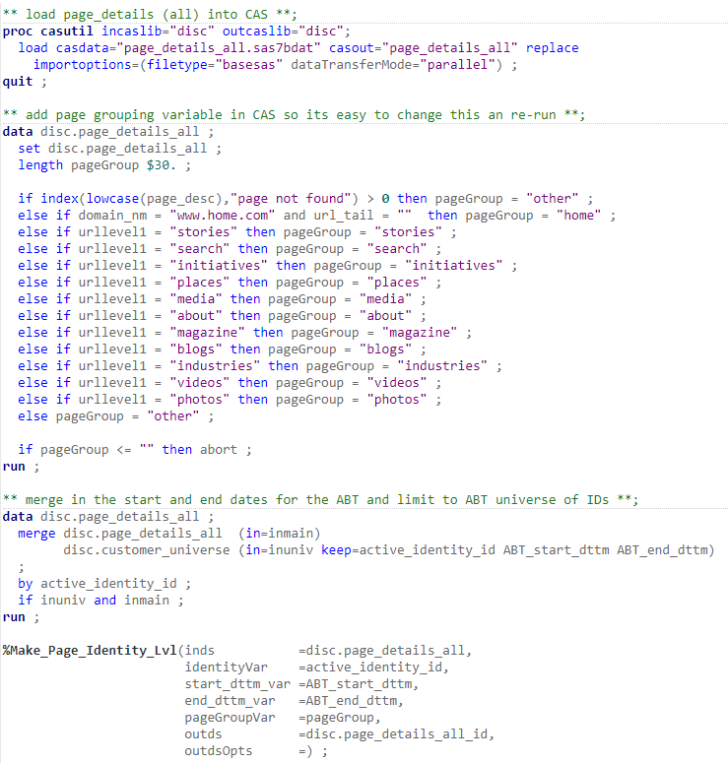
Example 2: create a customer level ABT
Page details data processing:
Load CI360 table into CAS
Optionally, create/define a page “group” variable so that the metrics will be created for each value of page group
Merge page details data with the customer universe to keep only those customers/datetime values that are in scope
Invoke the macro to create the page details metrics at identity level
(not shown) Drop CAS in memory tables no longer needed

Slide 51
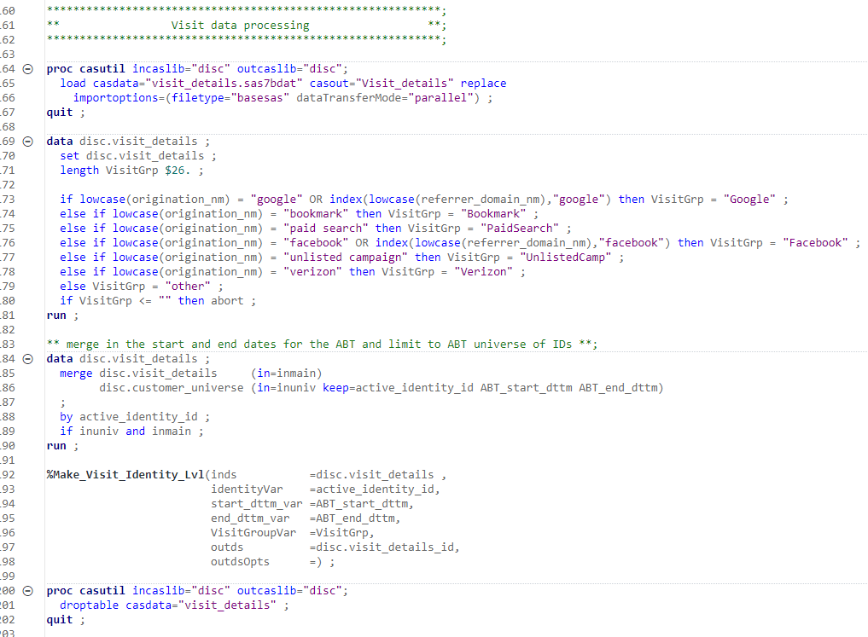
Example 2: create a customer level ABT
Visit details data processing:
Load CI360 table into CAS
Optionally, create/define a visit “group” variable so that the metrics will be created for each value of visit group
Merge visit details data with the customer universe to keep only those customers/datetime values that are in scope
Invoke the macro to create the visit details metrics at identity level
Drop CAS in memory tables no longer needed

Slide 52
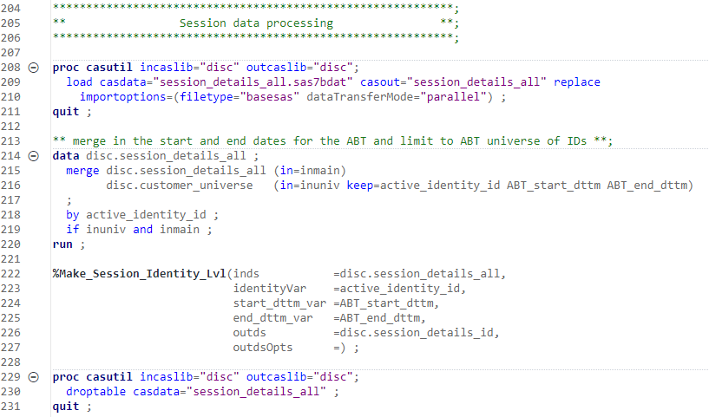
Example 2: create a customer level ABT
Session details data processing:
Load CI360 table into CAS
Merge session details data with the customer universe to keep only those customers/datetime values that are in scope
Invoke the macro to create the session details metrics at identity level
Drop CAS in memory tables no longer needed

Slide 53
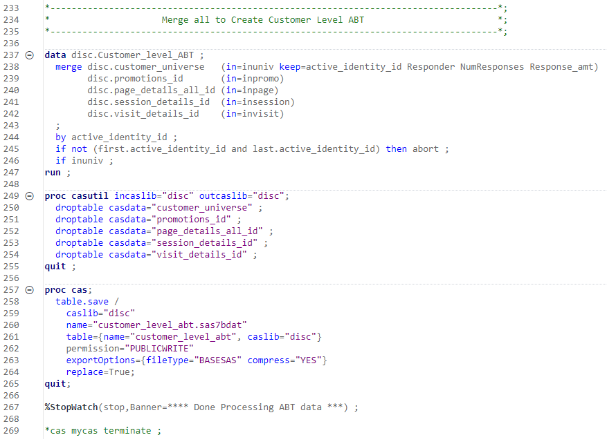
Example 2: create a customer level ABT
Combine into one ABT:
Merge all of the identity level datasets into a single ABT
Drop CAS in memory tables no longer needed
Save the ABT from memory to SAS dataset
Run “stop” stopwatch macro to measure total run time
Terminate the CAS session

Slide 54
Create recommender

Slide 55
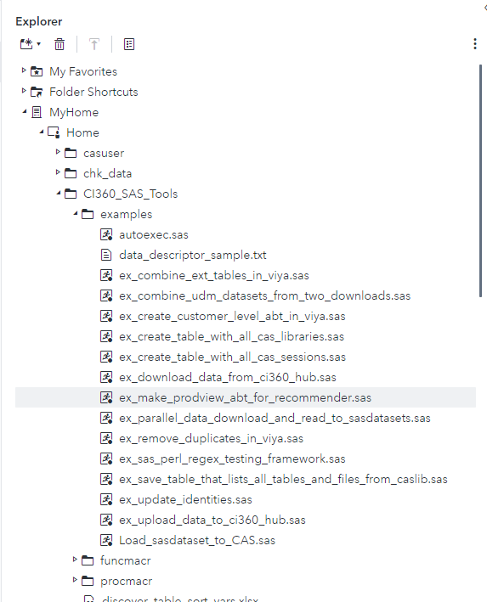
Example 3: create customer product recommendations
Leverage the example code to create the ABT for product recommendations using proc factmac

Slide 56
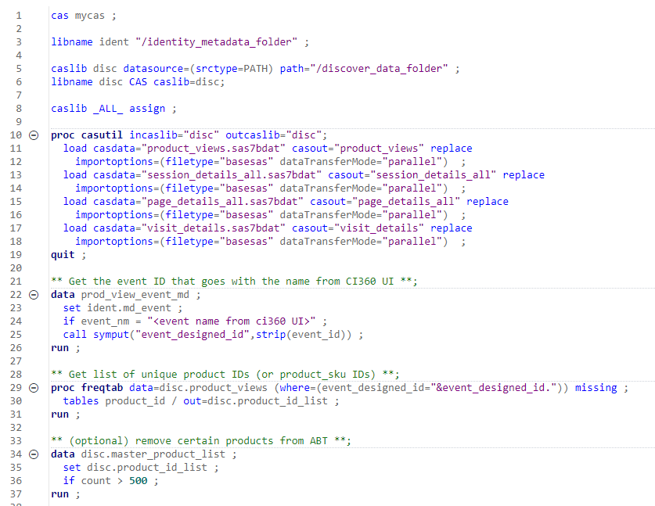
Example 3: create customer product recommendations
Step 1: Create the ABT for product recommendations
Start CAS session
Create caslib/libname to discover and metadata
Load the four input tables into CAS
Extract the event ID associated with the event name
Get list of unique product IDs
Optionally, create a list of product IDs to remove from ABT

Slide 57
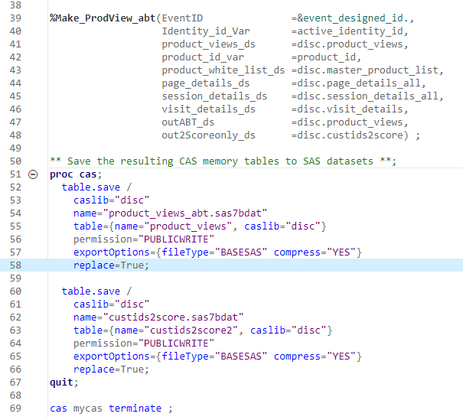
Example 3: create customer product recommendations
Step 2: Create the ABT for product recommendations
Invoke the make_prodview_abt macro
Save the resulting CAS tables to SAS datasets

Slide 58
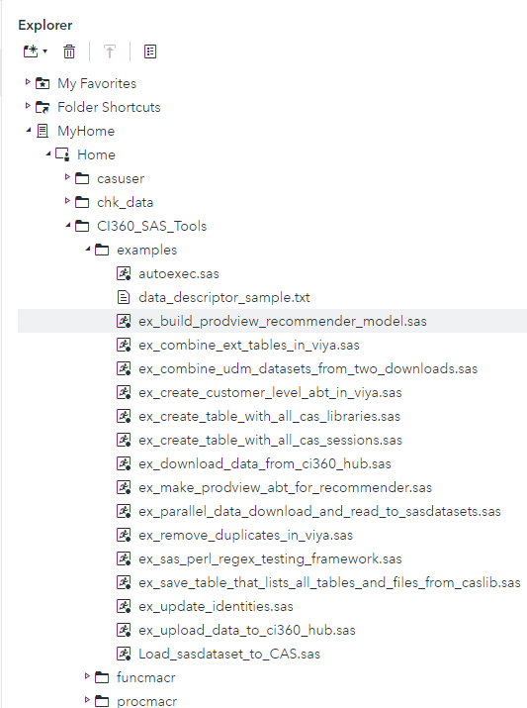
Example 3: create customer product recommendations
Leverage the example code to run proc factmac (Factorization Machines model) on the product views ABT created in the previous steps

Slide 59
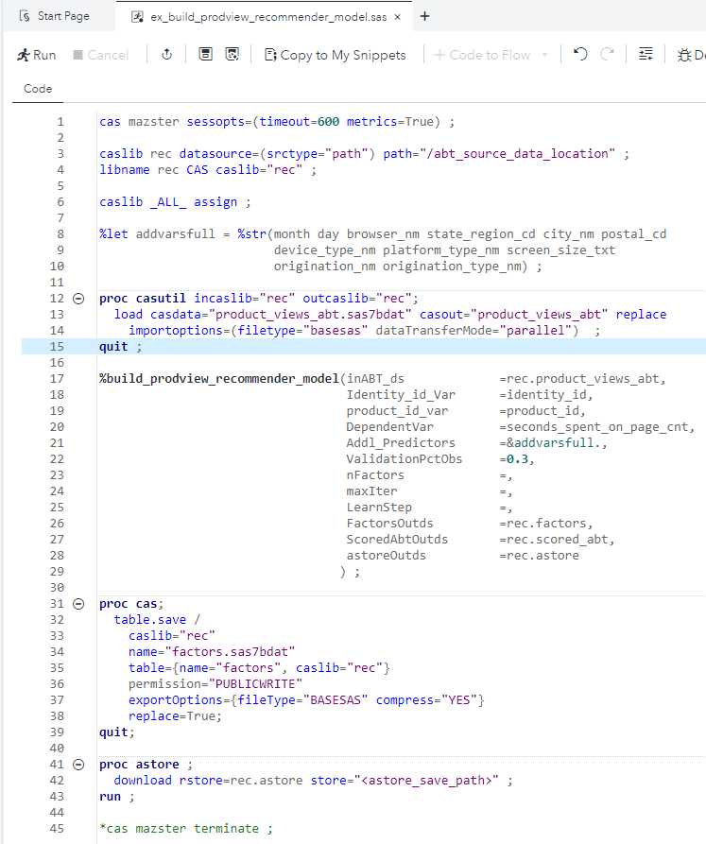
Example 3: create customer product recommendations
Create CAS session
Create caslib/libname to source ABT data
Load ABT data into CAS
Invoke the macro to run proc factmac
Save the resulting factors and astore

Slide 60
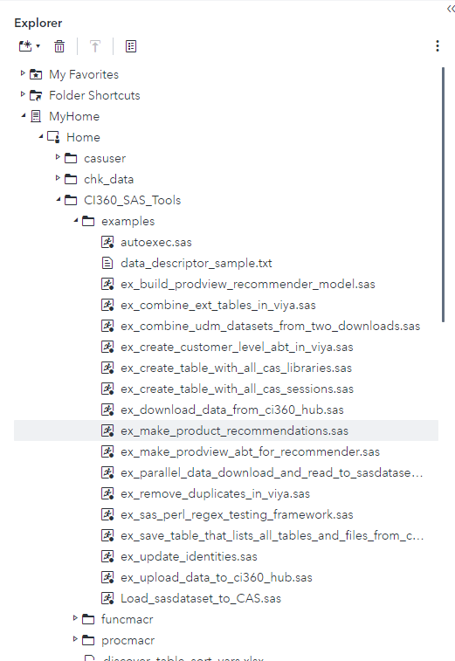
Example 3: create customer product recommendations
Leverage the example code that produces the top X product recommendations for each identity

Slide 61
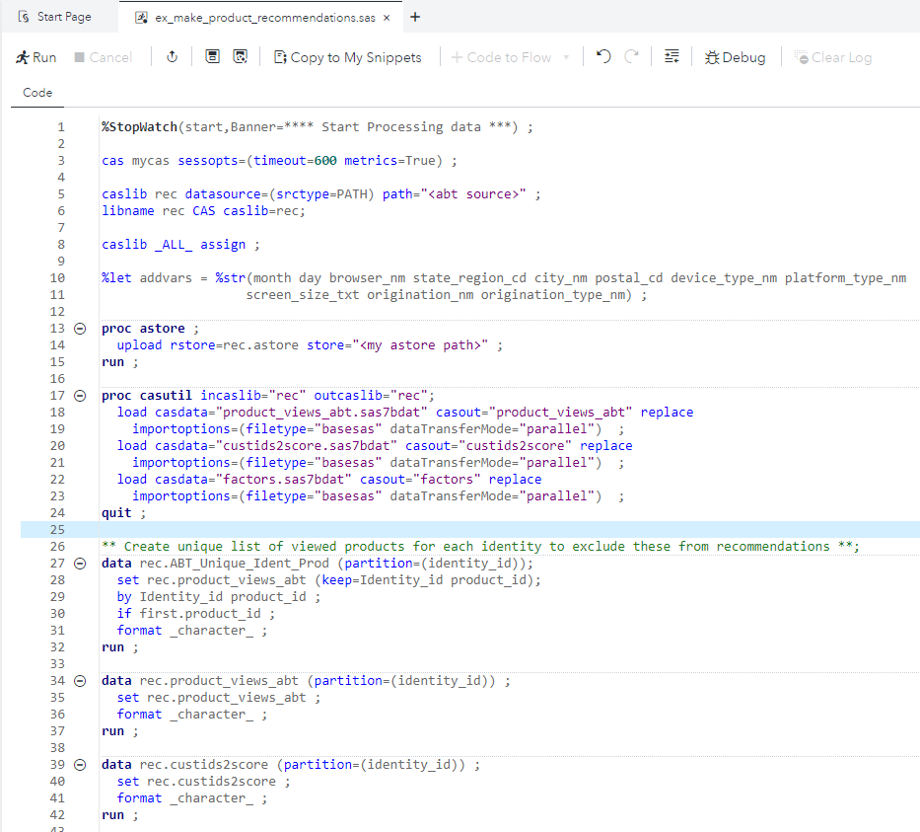
Example 3: create customer product recommendations
Create CAS session
Create caslib/libname to source ABT data
Load astore into CAS
Load model ABT and model output data into CAS
Partition the datasets by identity ID to speed up data processing and remove character formats from data

Slide 62
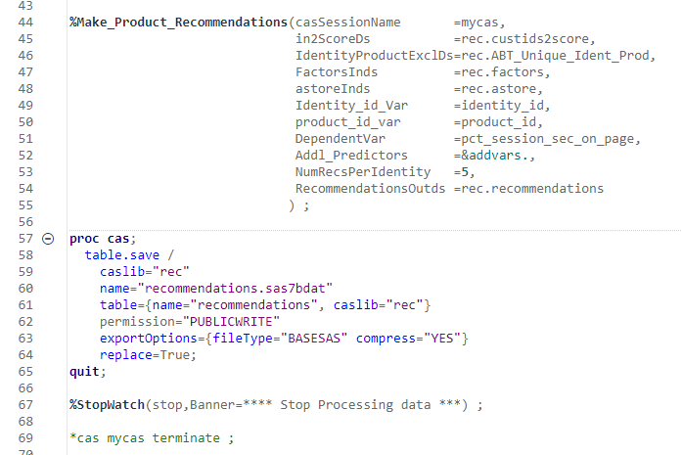
Example 3: create customer product recommendations
Invoke the macro to generate the identity level product recommendations
Save the resulting CAS table to disk as SAS dataset

Slide 63
Upload analytic results to CI360

Slide 64
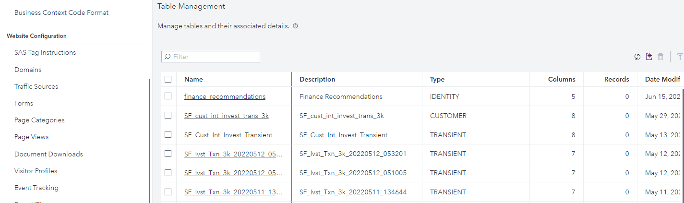
Upload Customer data
Can use CI360 UI to upload the data. Go to General Settings | Data Collection | Table Management

Slide 65
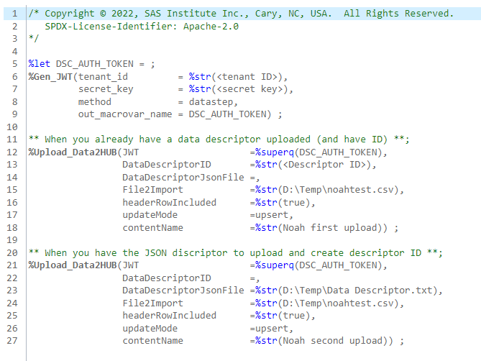
Upload Customer data
Or can use API via SAS code to automate the process of uploading customer data for use in personalization and targeting with CI360

